Slide 1
Forecasting of
COVID-19 Kaggle data
Project Presentation
Aruvi Puhazhendhi
Masters in Artificial Intelligence
Khoury college of computer sciences

Slide 2
overview
Problem
Data
Approach
Evaluation
Results
Work in Progress

Slide 3
Problem
As we all know, the issue that is shaking the globe right now is COVID-19
Understanding how the trends of spread has been and forecasting it will help organizations like WHO and White House Office of Science and Policy
The primary goal of this project is to forecast the number of estimated confirmed cases and deaths due to covid-19 in the days to come
We will additionally also try to identify factors that impact the transmission of the virus
Apart from this we will try to analyze if there are racial biases in the conversations about covid-19 on Reddit

Slide 4
Forecasting - Approach
DATA:
1. Kaggle data set that consists of confirmed cases and fatalities due to COVID-19 across countries and provinces
The data is on a daily level and starts from last week of January 2020 and ends with data till 2 days ago (12th of April, 2020)
2. We will additionally use external data sources that consists of factors that might affect the transmission rate such as, starting dates of social lockdowns, population density numbers, average flight passengers, number of migrants etc.,

Slide 5
Forecasting - Approach
Algorithm:
The prediction algorithm that will be used is an auto-regressive model. It generally is used to describe certain time-varying processes in nature, economics, etc. The autoregressive model specifies that the output variable depends linearly on its own previous values and on a stochastic term (an imperfectly predictable term); thus the model is in the form of a stochastic difference equation (or recurrence relation which should not be confused with differential equation).
The way COVID-19 spreads, is from an individual to other people. The number of positive cases yesterday directly affects the number of positive cases today. Since the problem of COVID-19 depends on its own previous values to a great degree, and since this is a time-varying process an auto-regressive linear model is appropriate.
There is a lot of attention on this topic and people are using various time series methods, RNN(recurring neural networks), SIR models, random forests and predictive analytics to arrive at a good prediction.

Slide 6
Forecasting - Approach
Algorithm:
We use sklearn.model_selection’s TimeSeriesSplit to prepare our data into a time series format
We try 3 algorithms on our data to forecast the Covid-19 confirmed cases and fatalities
Auto Regressive Elastic Net : Elastic-Net is a linear regression model trained with both ℓ1 and ℓ2-norm regularization of the coefficients. Elastic-net is useful when there are multiple features which are correlated with one another. Lasso is likely to pick one of these at random, while elastic-net is likely to pick both
Random Forest Regressor : A random forest is a meta estimator that fits a number of classifying decision trees on various sub-samples of the dataset and uses averaging to improve the predictive accuracy and control over-fitting.
Recurring Neural Network : A recurrent neural network deals with sequence problems because their connections form a directed cycle. In other words, they can retain state from one iteration to the next by using their own output as input for the next step.

Slide 7
Forecasting - Approach
Evaluation:
We estimate the Root Mean Squared Logarithmic Error (RMSLE) value after getting the results to evaluate the model. RMSLE measures the ratio between log of actual and log of predicted.
SLE = (log(prediction + 1) - log(actual + 1))^2
RMSLE = sqrt(mean(squared logarithmic errors))

Slide 8
Topic Modelling - Approach
Algorithm:
Additionally we will also be extracting Reddit threads on covid-19. We will preprocess and vectorize the data using
Bag of words
Tf-Idf
Following this we will run a topic model on this to analyze the different topics that are being discussed about to see patterns or racism or discrimination in the conversations and comments

Slide 9
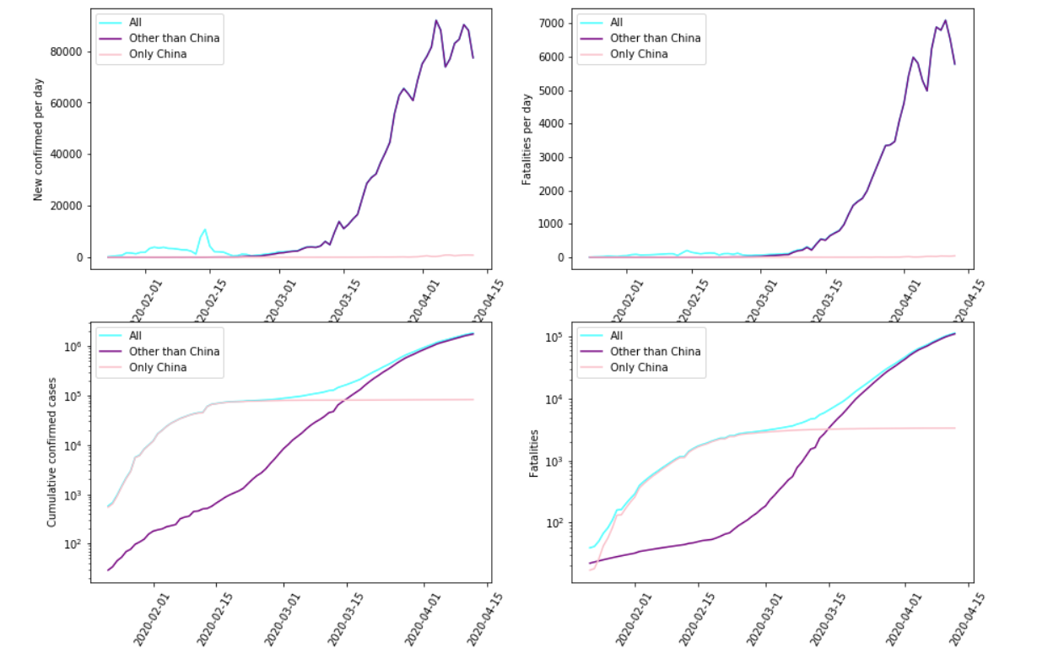
Forecasting – Data Exploration

Slide 10
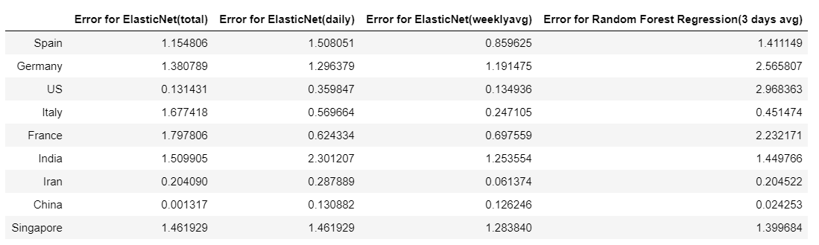
Forecasting - RMSLE for confirmed cases

Slide 11
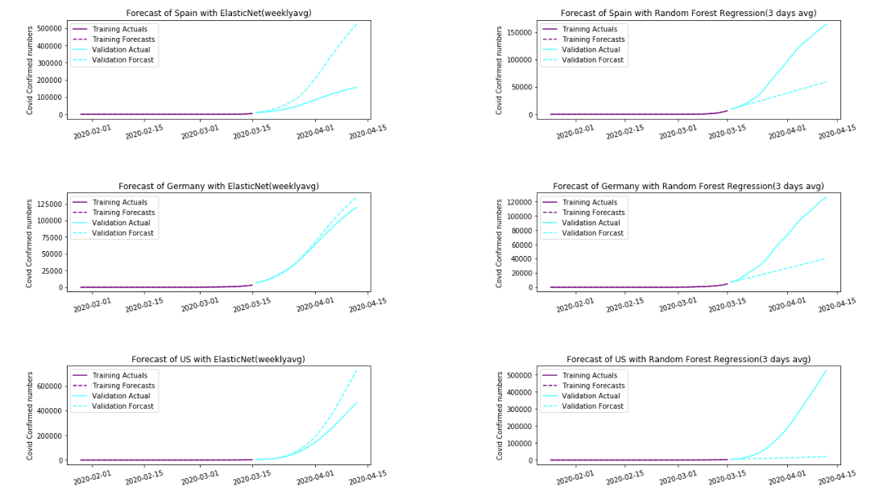
Confirmed Cases – Spain, GERMAN and US

Slide 12
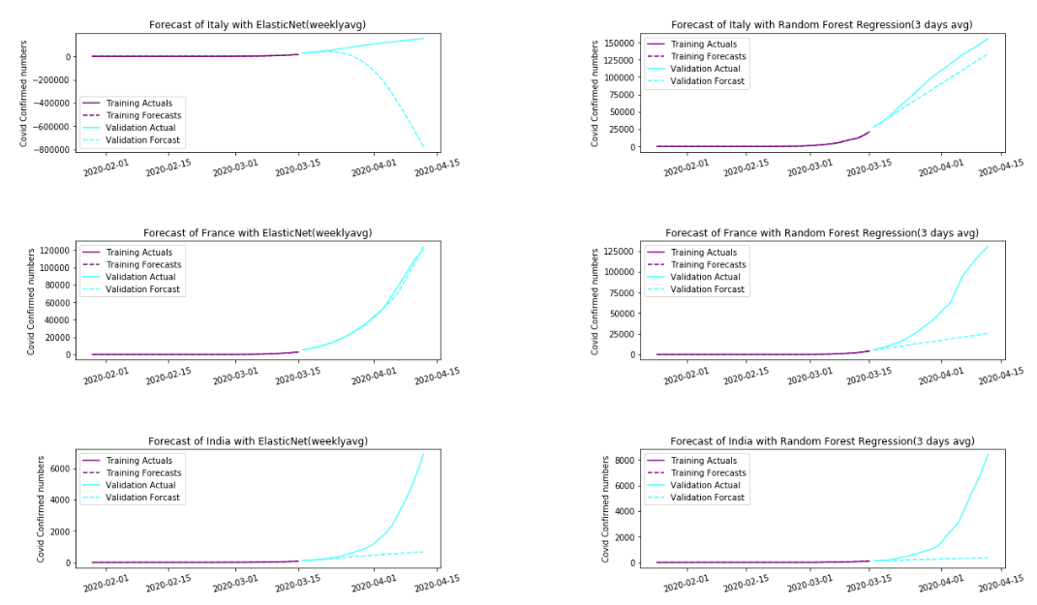
Confirmed Cases – Italy, France and India

Slide 13
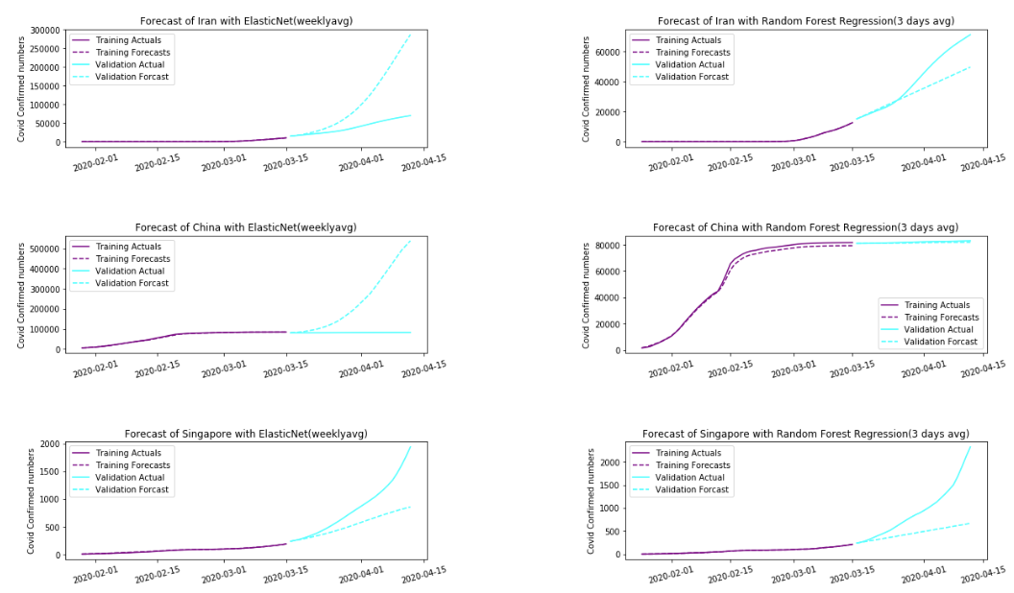
Confirmed Cases – Iran, china and Singapore

Slide 14
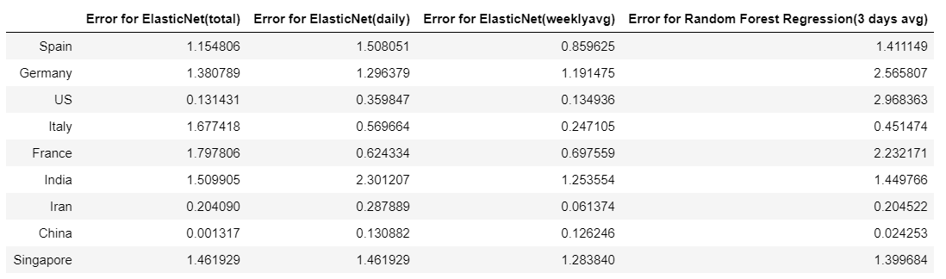
Forecasting - RMSLE for fatalities

Slide 15
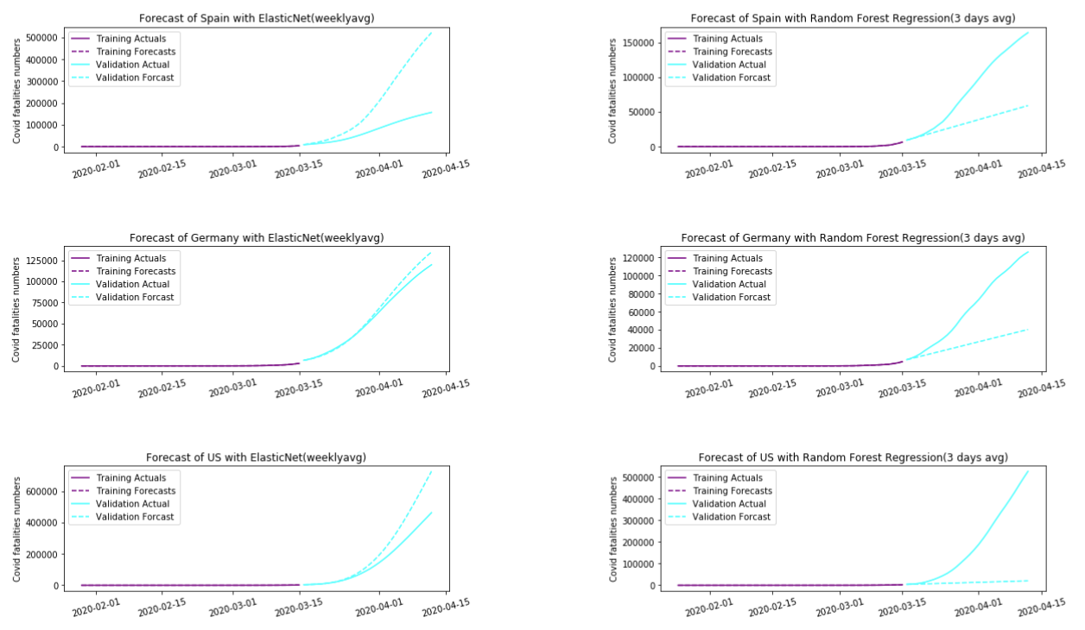
Fatalities – Spain, GERMAN and US

Slide 16
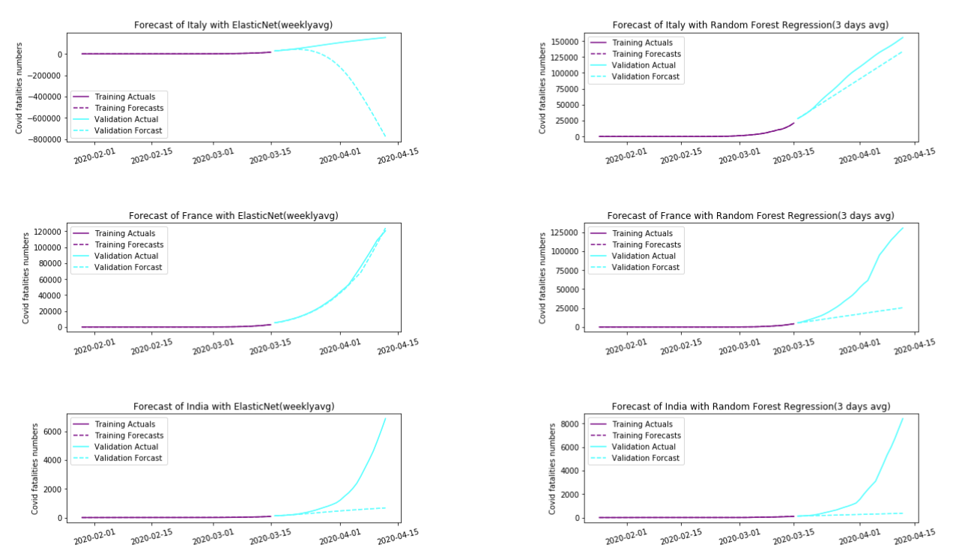
Fatalities– Italy, France and India

Slide 17
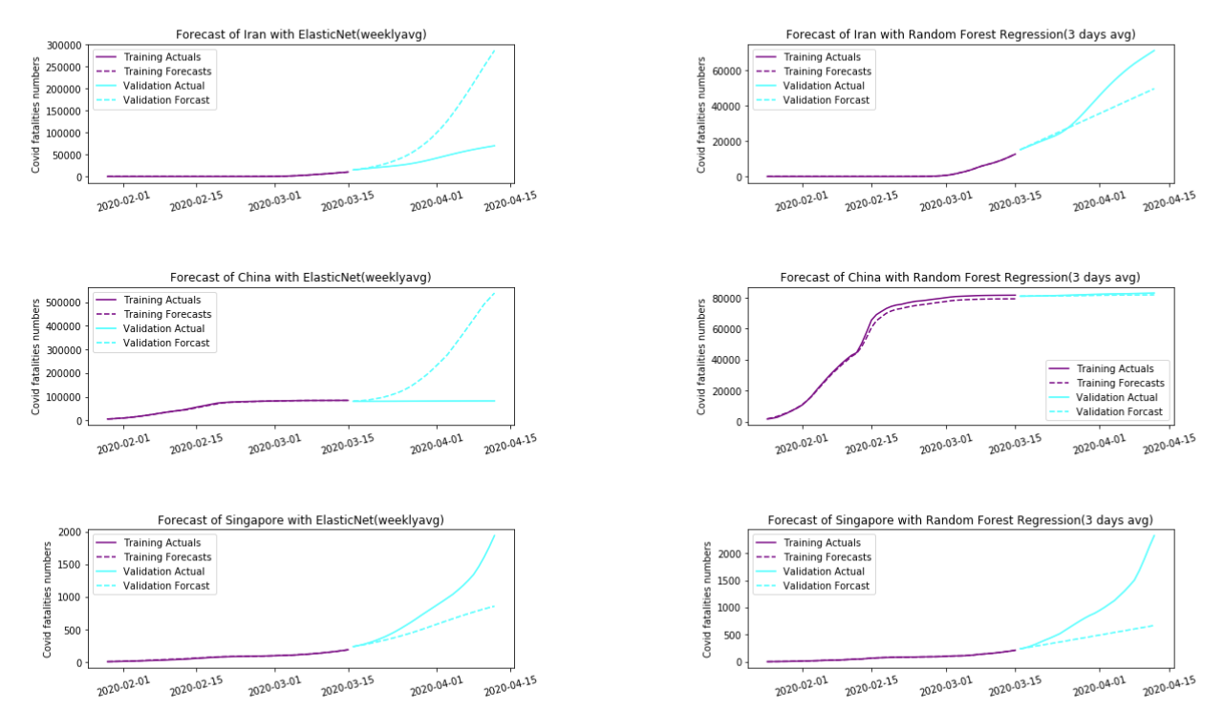
Fatalities – Iran, china and Singapore

Slide 18
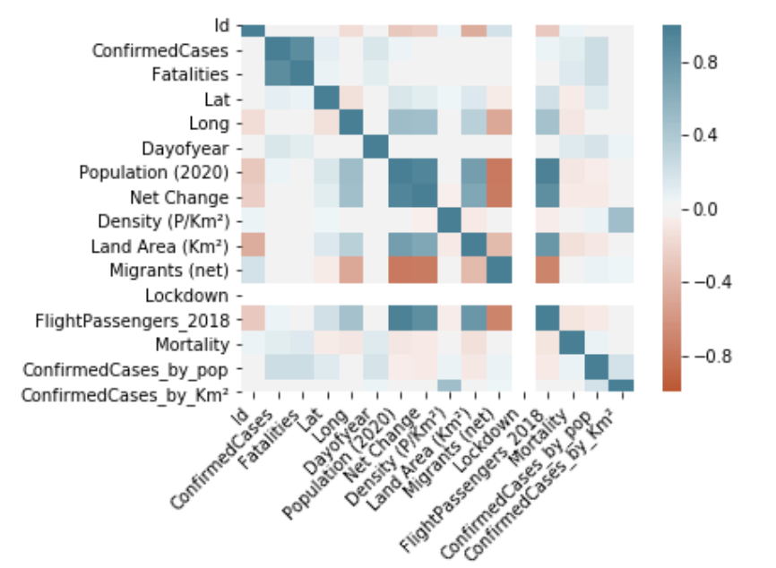
Correlation matrix with possibly related variables

Slide 19
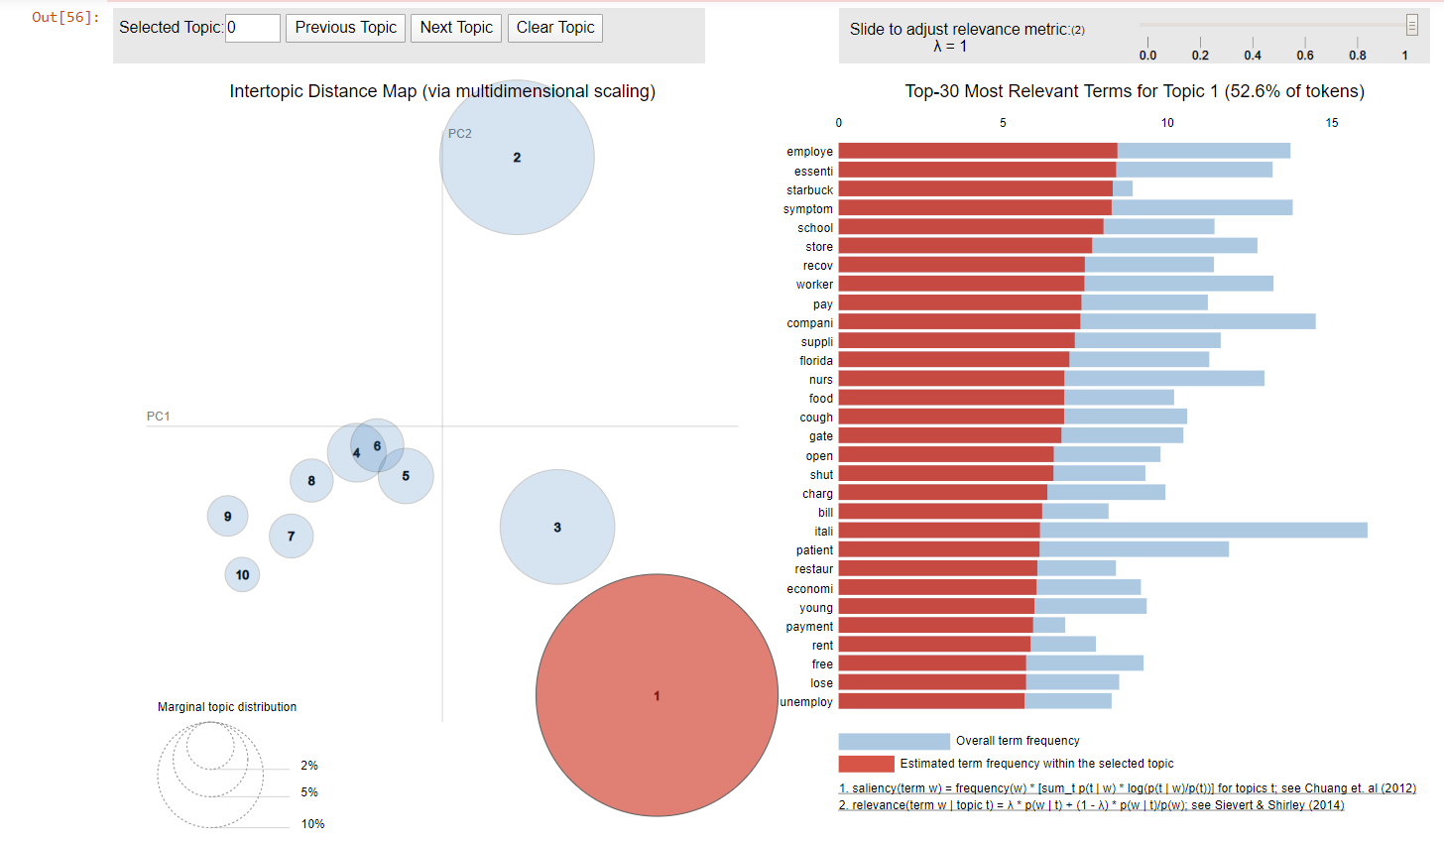
Topic modelling - TF-IDF

Slide 20
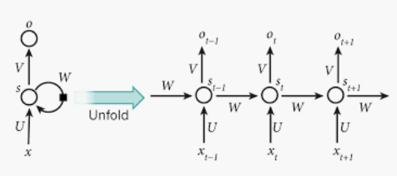
Work in Progress
The RNN model and the corresponding resulting charts with the RMSLE values are work in progress and hoping to deliver in the report

